Slide 1


Slide 2

Louisiana Center for Safe Schools
Develop a comprehensive planning/training model that will ensure all stakeholders can adopt and or integrate in their current school safety plans.
  Prepare school systems to respond to and recover from emergencies and disasters at the individual, local, and state levels.
  Increase intelligence, information sharing, and situational awareness capabilities.
  Document, assess, and facilitate the enhancement of protective measures for schools to reduce vulnerability.
  Participate in specific exercises, drills, meetings, workshops, and trainings on emergency preparedness coordination.

Slide 3
Department of Justice COPS School Safety Office’s
10 Actions to Improve School Safety
Plan
Evaluate
Train/ Equip
Exercise
Comprehensive School Safety Assessment
School Climate
Campus, Building, and Classroom Security
Anonymous Reporting Systems
Coordination with First Responders
Behavior Threat Assessment and Management Teams
School-Based Law Enforcement
Mental Health Resources
Drills
Social Media Research (not Monitoring)

Slide 4
Historical Perspective
2001
Developed the Louisiana School and Campus Safety Planning Guide
2013
La. R.S. 17:416.16 (2013 HB718/Act50)
Requiring school crisis management/response plans
2014
US DOE - Grants for School Emergency Management (GSEM)
Louisiana State Police create the Safety and Security Checklist
Louisiana School Emergency Management Program (LA SEMP)
2015
US DOE – GSEM Continued, Awarded to LDOE & LSU NCBRT/ACE
Provide training and assistance to schools for Highly Effective School EOPs

Slide 5
Historical Perspective
2018
Blue Ribbon Commission
2018
2020
GOHSEP Monthly Collaborative Calls for programs and services
LSP initiates Panic Button to improve responses to active threats or crisis
2019
GOHSEP & LSP hires dedicated personnel for school safety
Whole-Community Stakeholder Engagement Philosophy is developed
Launched the Louisiana Center for Safe Schools Website for resources
LSP secured COPS (SVPP) Grant & BJA (STOP) Grants
LSPsecures statewide anonymous reporting system

Slide 6
Historical Perspective
2020
GOHSEP joined the National School Safety Alliance
2021
2022
LDOE/LSP hosts Inaugural School Safety Summit
LA SAFE houses RAVE Command View for responder coordination
HR 218 acknowledges school safety & requests information on measures being taken
Member of the National School Safety Alliance Board of Directors
LA SAFE Fusion Center hires an additional Grant/Program Manager
2021
LDOE encourages LEAs to designate an Emergency Preparedness and Disaster Recovery Points of Contact

Slide 7
Historical Perspective
2022
LDOE/LSP/GOHSEP 2nd Annual School Safety Summit
GOHSEP takes charge of school safety solutions from La SAFE Fusion
2023
2023
GOHSEP continues on the NSSA Board of Directors
Bipartisan Congressional Delegation and NSSA Board visit Marjorie Stoneman Douglas High School in Parkland, Florida
2023
Louisiana Legislative Auditor’s begin the Elementary and Secondary Public School Safety Planning Report
Historical legislative session for school safety in Louisiana

Slide 8
Historical Perspective
2024
Jacques Thibodeaux is named Director of GOHSEP
2024
LCSS partnership with SDMI for Statewide Dashboards & reporting
School Safety Section is developed within GOHSEP, Director, Branch Manager, Program Manager, Specialists, & Area Coordinators
2024
LCSS launches the School & Nonprofit Security Grant Program
LCSS prepares the annual school safety report for the Governor & legislature.
LCSS releases the Data Call Questionnaire to meet reporting requirements of the School Safety Act of 2023

Slide 9
SB 207 – ACT 334: SCHOOL SAFETY ACT OF 2023
Act 334: SB 207 (Milligan) : to provide relative to school crisis management and response plans; to provide for additional safety drills; (Effective 6.13.23)
To amend and reenact R.S. 17:416.16(A), (B), (C)(1) , (D), (E), (F), (H), and (I), and R.S. 29:726.5 and to enact R.S. 17:416.16(G)(4) and (5) and R.S. 29:726.5.1, relative to school safety; school crisis management and response plans; for additional safety drills; require bleeding control kits and trainings; training for traumatic injury response; liability for rendering aid; duties and membership of the Louisiana Commission on School and Nonprofit Security; for the Louisiana Center for Safe Schools.
§726.5.1. Louisiana Center for Safe Schools; creation, duties (p. 9 of Act 334)
A. The Louisiana Center for Safe Schools, referred to in this Section as the "center", shall be established within GOHSEP.

Slide 10
Louisiana Commission on School and Nonprofit Security
P. 8-9
The commission shall provide oversight of the Louisiana Center for Safe Schools. The commission shall annually report to the governor on the activities of the center and any identified needs of the center.
The commission shall provide recommendations to the legislature relative to legislative changes for increasing school safety.
The LCSS shall provide an annual report to the governor, BESE, and the Senate & House Committees on Education regarding the status of school safety in Louisiana, the work of the center, and resources identified to increase school safety.

Slide 11
WHOLE COMMUNITY STAKEHOLDER ENGAGEMENT
TO BUILD COMMUNITY RESILENCY
Director of GOHSEP
Senate Homeland Security Chair
State Police Superintendent
Sheriff’s Association Director
LA Interchurch Conference Director
House Homeland Security Chair
LDOE Superintendent
Law Enforcement Commission Director
School Board Association Director
School Superintendent Director
Public Charter School Director
Nonpublic School Commission Chair
Rural OHSEP Director
Metro OHSEP Director
LA Chiefs of Police Director
LA Emergency # Association President
Louisiana State Fire Marshal
Dept. of Health Secretary
Child & Family Services Secretary
Senate Education Committee Chair
House Education Committee Chair
LA Educators Teacher
LA Teachers Federation Teacher
Legislative Youth Advisory Council Representative
P. 6-8

Slide 12
SCHOOL SAFETY ACT OF 2023
COMPLIANCE DEADLINES
No later than December 1, 2023, the LCSS shall provide a statewide:
Panic emergency notification system - Louisiana Panic Button App
Anonymous reporting system - Safe Schools Louisiana App
No later than April 1, 2024, each city, state, or other local school board shall implement the use of the panic emergency notification system and the anonymous reporting system or other systems of equal or exceeding capability. No later than May 1, 2024, each local school board shall report the systems implemented to BESE and the Center. (Act 334: P. 10; lines 9-26)

Slide 13
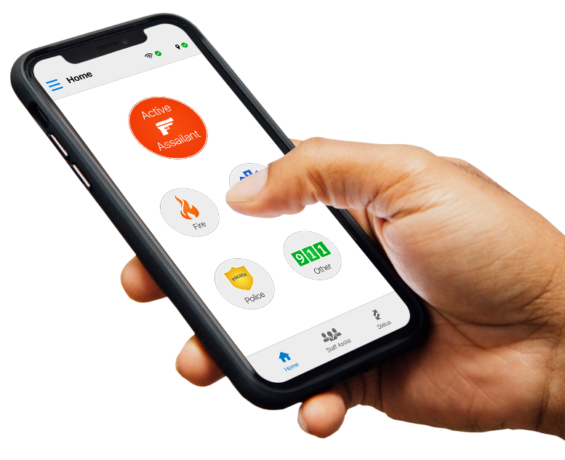
Louisiana Panic Button
Emergency Notification System
Rave Panic Button is offered free to all K-12 campuses and intended for administrators, faculty, and staff; not students. The App accelerates emergency response by placing a 911 call while simultaneously sending an In-App notification, Text message, and Email to school faculty & staff to become “immediate” responders until “first” responders arrive. The 911 centers receive critical incident information through RAVE Command View based on the schools profile.
69% of all public, private, and charter schools have opted into the statewide program.
52% of all public, private, and charter schools have trained their faculty and staff, deployed the application, and are live and operational.

Slide 14

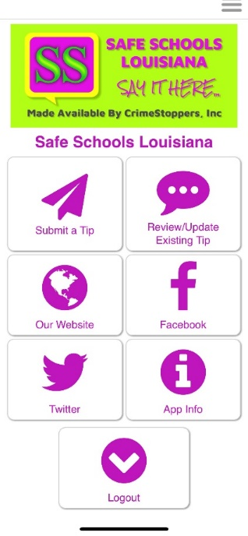
Safe Schools Louisiana
Anonymous Reporting System
The Safe Schools Louisiana App is offered free to students in grades 6 through 12 statewide; public, private, and charter. The app allows students to share what they know with faculty, staff, counselors, and law enforcement, who can then prevent the preventable.
There have been 19,000 downloads of the application to date.
An average of 600 tips are submitted annual, just over 1,000 in 2023.
Currently, about 40% of all public, private, and charter schools within the qualifying grade groups have opted into the program.
A total of 2,284 tips have been processed since 2020 when the program began.

Slide 15
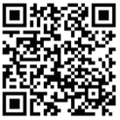
LCSS
Data Call Questionnaire
To ensure compliance with the School Safety Act and provide support in improving school safety programs, the Louisiana Center for Safe Schools at GOHSEP in collaboration with Louisiana State University conducted a statewide data call with all K-12 schools.
The Questionnaire includes the topics in compliance with the School Safety Act of 2023 such as security assessments, crisis plans, emergency notification platforms, anonymous reporting, district threat assessment teams, SROs and more. These details establish baseline data for future federal and state funding applications in school safety.
LCSS School Safety Dashboard
For additional questions, please contact us at safeschools@la.gov

Slide 16
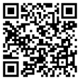
LCSS
School and Nonprofit Security Grant Program
The Fiscal Year Louisiana School and Nonprofit Security Grant Program (LSNSGP) (FY) 2024 is a -competitive, State-funded grant program for local school systems and non-profits to fund school safety and security-related projects. Authorized by the Louisiana Legislation to help strengthen Louisiana communities against potential acts of violence or other extremist attacks, priorities include: physical and security enhancements, enhancing the protection of soft targets/crowded places, effective planning; training and awareness campaigns; and exercises.
Available Funding FY24 LSNSGP | $5,000,000.00
Projected Number of Awards | Distribution by Regions, will vary.
Maximum Award Amount | $50,000.00

Slide 17
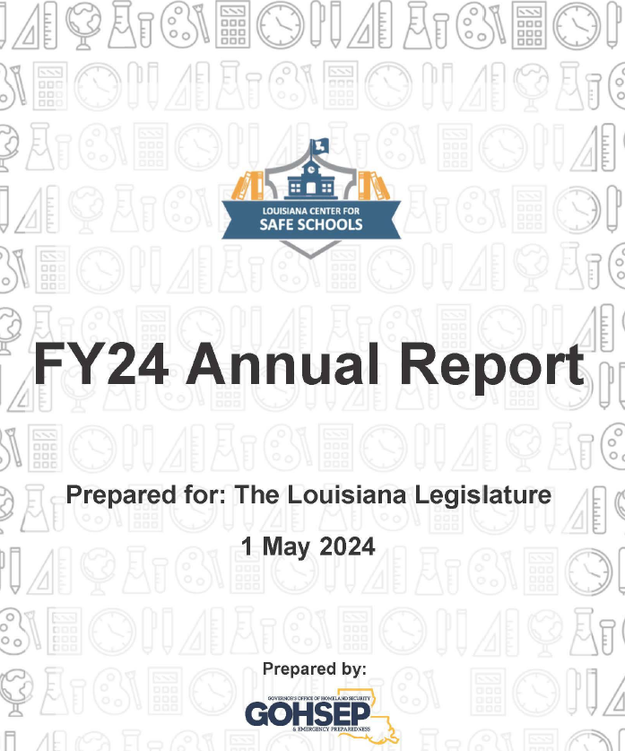
LCSS
School Safety Annual Report
Per Act 224 of 2023; P. 10, lines 4-8 (Paragraph C), “The center shall provide an annual report to the governor, the State Board of Elementary and Secondary Education, the Senate Committee on Education, and the House Committee on Education regarding the status of school safety in Louisiana, the work of the center and resources identified to increase school safety.”
LCSS is committed to continued growth and support to partner agencies and schools as we look into FY25. What has been achieved in the last quarter of FY24 is just the beginning. Creating safe learning environments require a collective effort at all levels of government and within the school systems, to include students, communities and families. By continuing to work together, committed to providing the resources needed, we will exceed mission requirements and make Louisiana schools a safe place for both educators and students.

Slide 18
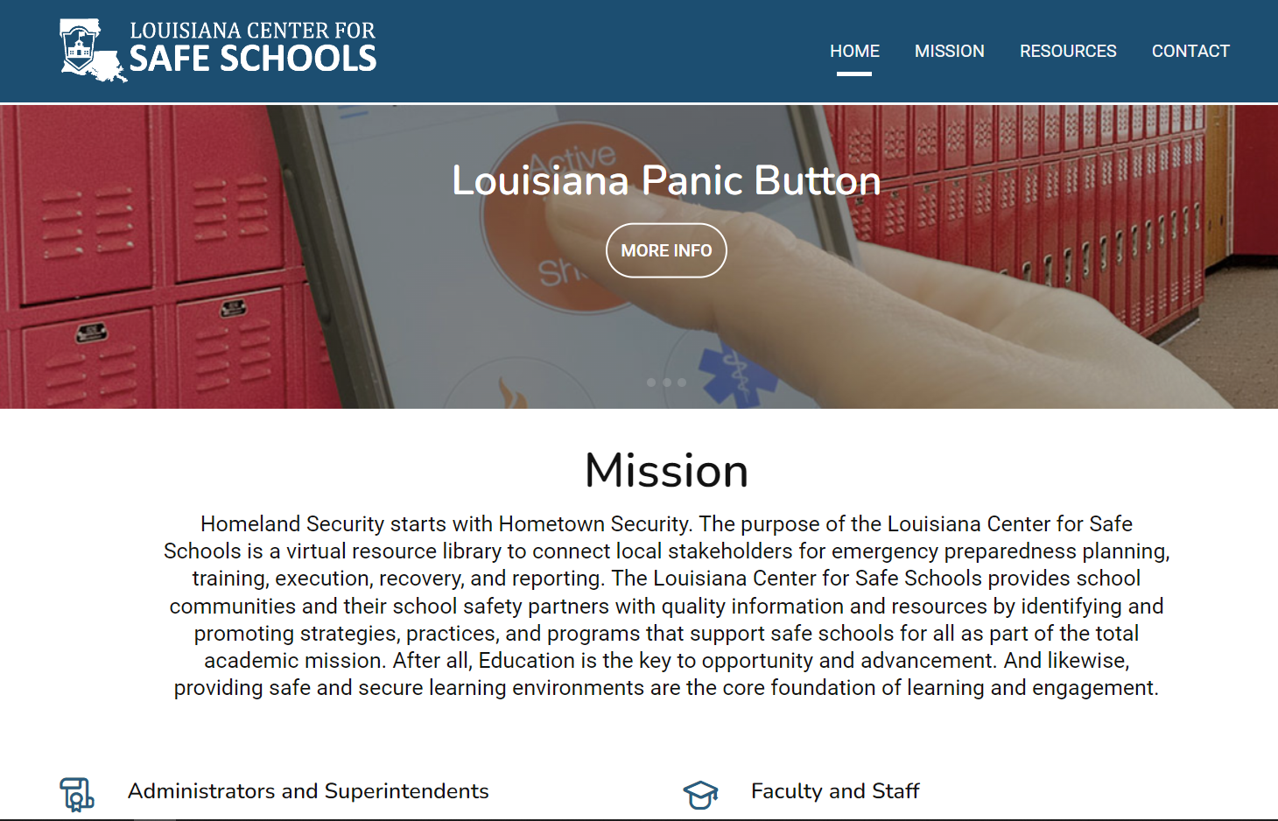
Louisiana Center for Safe Schools Website
  Administrators and Superintendents
  Parents and Students
  Faculty and Staff
  First Responders and Resource Officers
  Behavioral and Mental Health
  Louisiana Legislation
Website: https://lasafeschools.la.gov/

Slide 19
Trevis A. Thompson
Director – Louisiana Center for Safe Schools, GOHSEP
Trevis.Thompson@la.gov
225-258-5533 (office)
https://lasafeschools.la.gov/

